Slide 2
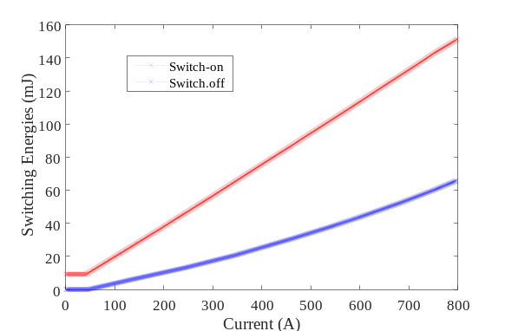
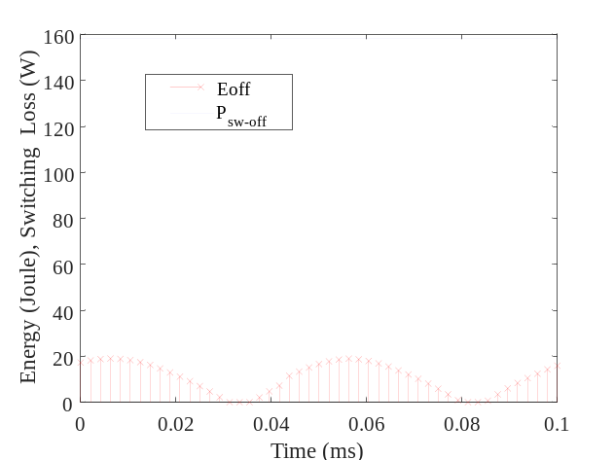
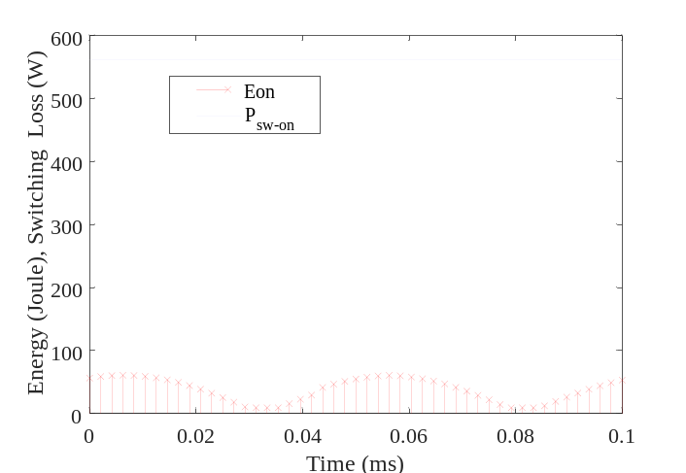
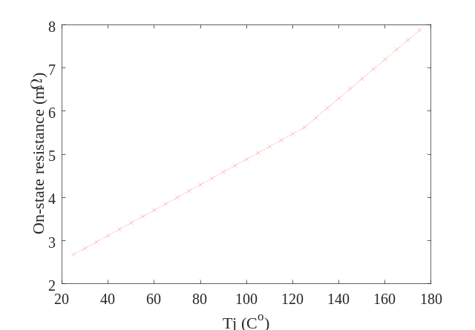
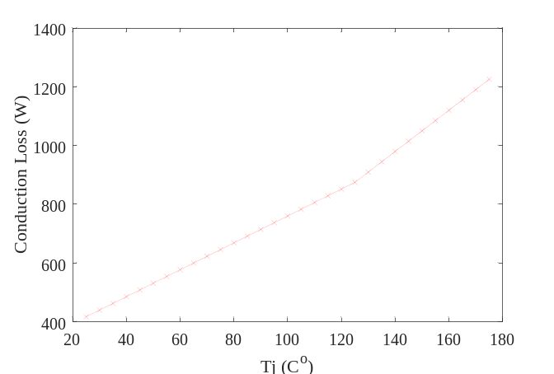
Datasheet-Driven Loss Estimation
Voltage rating: 2kV Current rating: 400A
FF3MR20KM1H using 10 dies in parallel
Switching energies
Switching Losses for sinusoidal current with 5kHz switching
On-state resistance
Conduction Loss

Slide 3
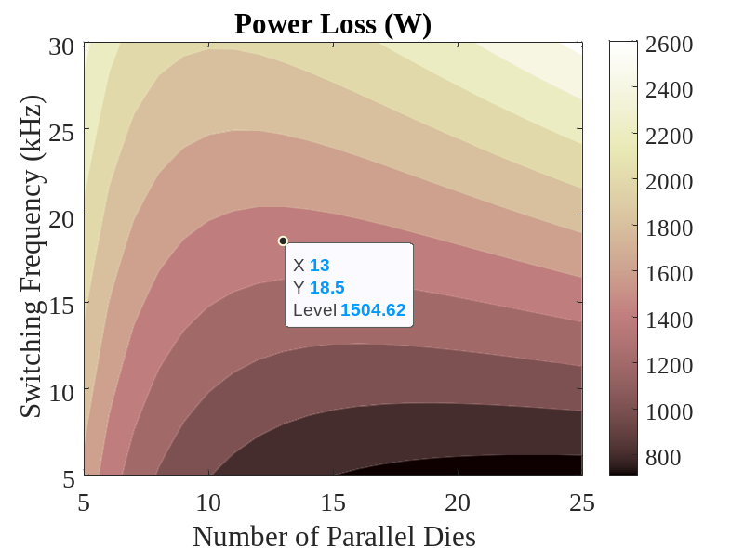
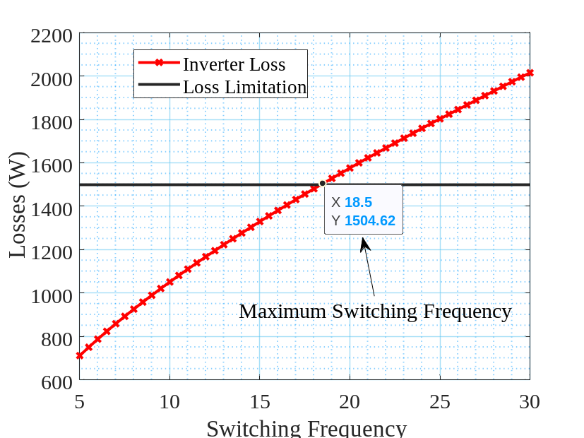
Die Area Optimization Regarding Inverter Losses
Number of Dies area selected as minimized the losses regarding the switching frequency.
Junction temperature is taken at $75 C^{o}$.

Slide 4
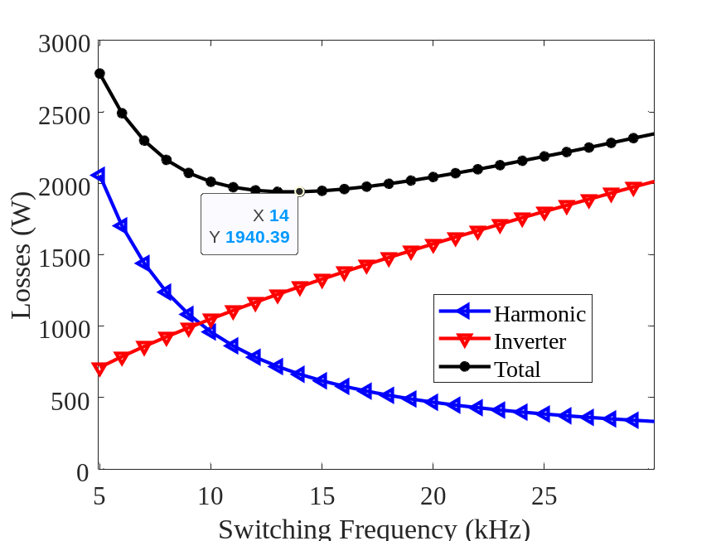
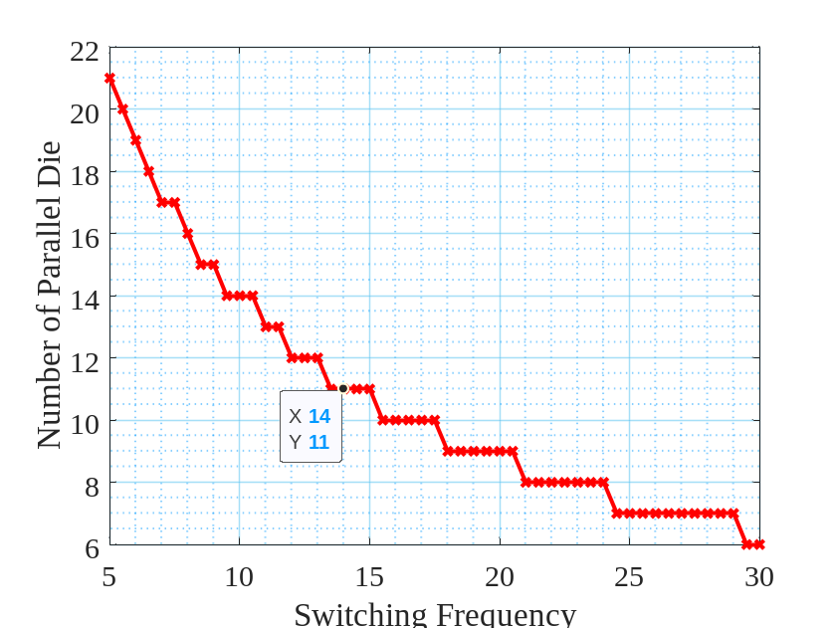
Die Area Optimization Regarding Inverter and Motor Harmonic Losses
Optimum switching frequency
Voltage rating: 2kV
Current rating: 440A
11 dies in parallel and 14 kHz switching frequency

